Slide 1

A Guide to MySQL

Slide 2
Objectives
Introduce Premiere Products, a company whose database is used as the basis for many of the examples throughout the text
Introduce Henry Books, a company whose database is used as a case that runs throughout the text
Introduce Alexamara Marina Group, a company whose database is used as an additional case that runs throughout the text
Introduce MySQL, a database management system

Slide 3
What Is a Database?
Database: structure containing categories of information and relationships between these categories
Examples of categories: sales reps, customers, orders, and parts
Relationships between categories: sales rep to customer and customer to orders

Slide 4
The Premiere Products Database
Premiere Products: distributor of appliances, house wares, and sporting goods
Manual systems no longer suitable for managing customer, order, and inventory data
Database management system will allow for current, accurate data and provide useful reports

Slide 5
Required Data for Sales Reps
Number
Last name
First name
Address
Total commission
Commission rate

Slide 6
Required Data for Customer
Customer number
Name
Address
Current balance
Credit limit
Sales rep number

Slide 7
Required Data for Parts
Part number
Description
Number of units on hand
Item class
Number of the warehouse where item is stored
Unit price for each part in inventory

Slide 8
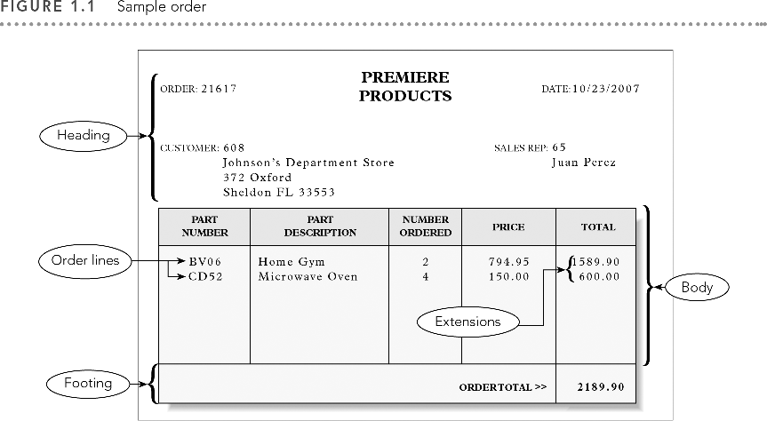

Slide 9
Components of a Sample Order
Heading (top): company name; order number and date; customer number, name, address; sales rep number and name
Body (center): one or more order lines or line items
Footer (bottom): order total

Slide 10
Components of a Line Item
Part number
Part description
Number of units for part ordered
Quoted price for part
Total, or extension: result of multiplying the number ordered by the quoted price

Slide 11
Items Stored for Each Order
Order number
Date of the order
Customer number
Customer name, address and sales rep information are stored with customer information
Sales rep name is stored with sales rep information

Slide 12
Items Stored for Each Order
Order number, part number, number of units ordered, and quoted price
Part description is stored with information about parts
Order total is not stored but calculated each time order is displayed or printed

Slide 13
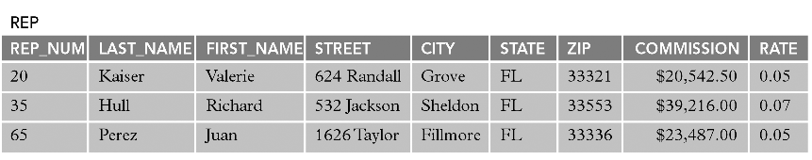
Sample Rep Table

Slide 14
Rep Table Example
Three sales reps in the table identified by number
  Sales rep number: 20
  Name: Valerie Kaiser
  Address: 624 Randall St., Grove, FL, 33321
  Total commission: $20,542.50
  Commission rate: 5% (0.05)

Slide 15
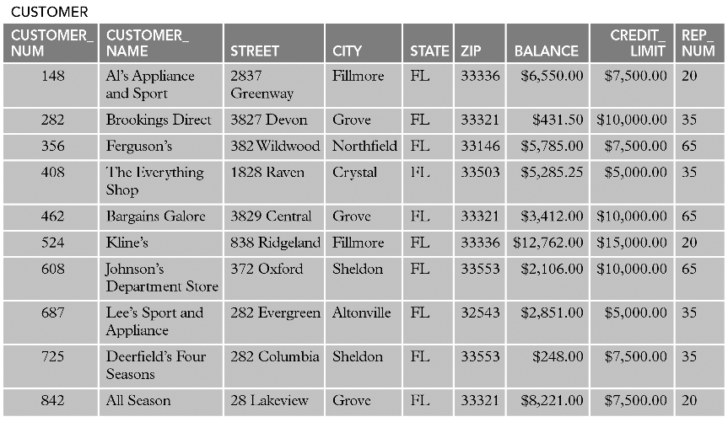
Sample Customer Table

Slide 16
Customer Table Example
Ten customers are identified by number
  Number: 148
  Name: Al’s Appliance and Sport
  Address: 2837 Greenway St., Fillmore, FL, 33336
  Current balance: $6,550.00
  Credit limit: $7,500.00
  Sales rep: 20 (Valerie Kaiser)

Slide 17
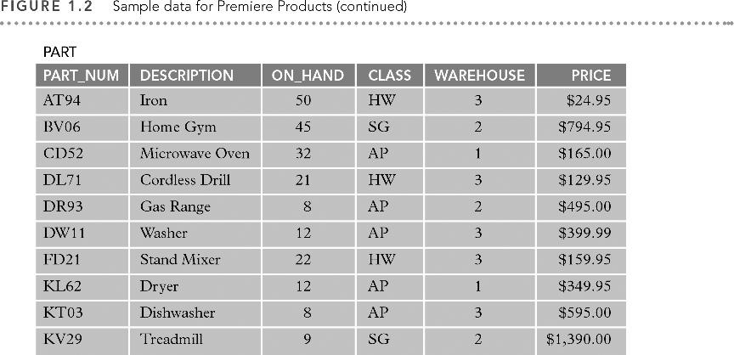

Slide 18
Part Table Example
Ten parts are listed by part number
  Part number: AT94
  Description: Iron
  Units on hand: 50
  Item class: HW (house wares)
  Warehouse: 3
  Price: $24.95

Slide 19
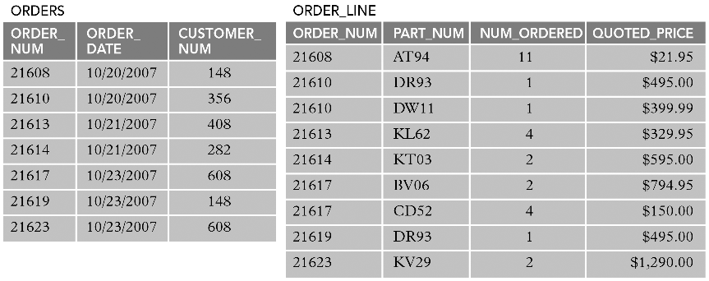
Sample Order Table

Slide 20
Order Table Example
Seven orders listed by order number
  Order number: 21608
  Order date: 10/20/2007
  Customer: 148 (Al’s Appliance and Sport)

Slide 21
Order_Line Table Example
Nine order line items listed by order number
  Order number: 21608
  Part number: AT94 (iron)
  Number ordered: 11
  Quoted price: $21.95

Slide 22
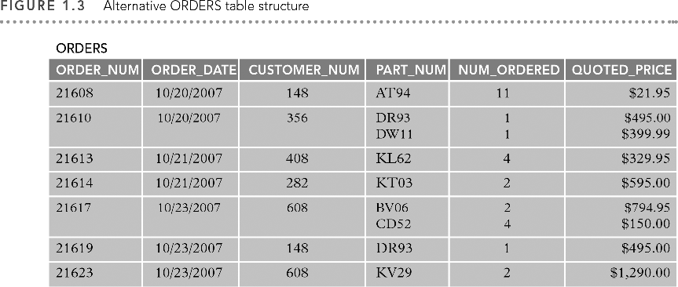

Slide 23
Alternate Order Table Example
Displays identical data in one table
Each table row contains all order lines for each order
Fifth row, order 21617 has two order lines:
  Part BV06, Qty 2, quoted price $794.95 each
  Part CD52, Qty 4, quoted price $150.00 each

Slide 24
Issues with Alternative Order Table
Difficult to track information between columns
Other issues:
  How much room is allowed for multiple entries?
  What if an order has more order lines than you have allowed room for?
  For a given part, how do you determine which orders contain order lines for that part?

Slide 25
Benefits of Order_Line Table
Table is less complicated when separated
No multiple entries
Number of order lines is not limited
Finding every order for a given part is simple

Slide 26
Henry Books Database
Ray Henry owns Henry Books, a bookstore chain
Data is to be stored in a database
Needs forms and reports to work with the data
In running chain of bookstores, gathers variety of information on branches, publishers, authors, books

Slide 27
Data for Branch Table
Number
Name
Location
Number of employees

Slide 28
Data for Publisher Table
Publisher code
Publisher name
City

Slide 29
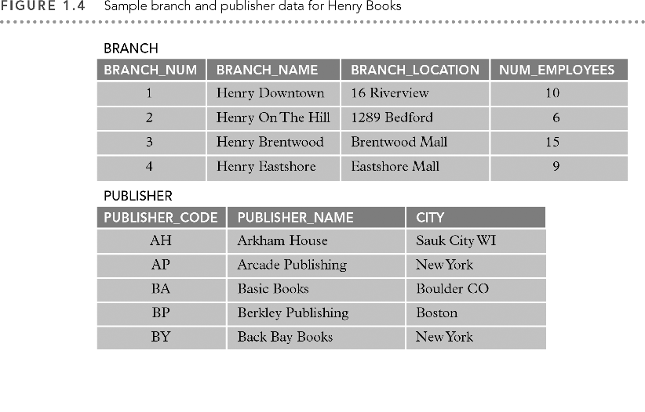

Slide 30
Data for Author Table
Author number
Last name
First name

Slide 31
Data for Book Table
Book code
Title
Publisher code
Type of book
Price
Is it a paperback?

Slide 32
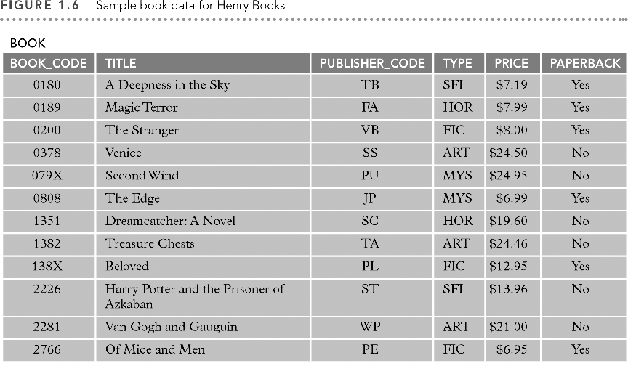

Slide 33
Data for Wrote Table
Book code
Author number
Sequence (for books with multiple authors)

Slide 34
Data for Inventory Table
Book code
Branch number
Quantity on hand

Slide 35
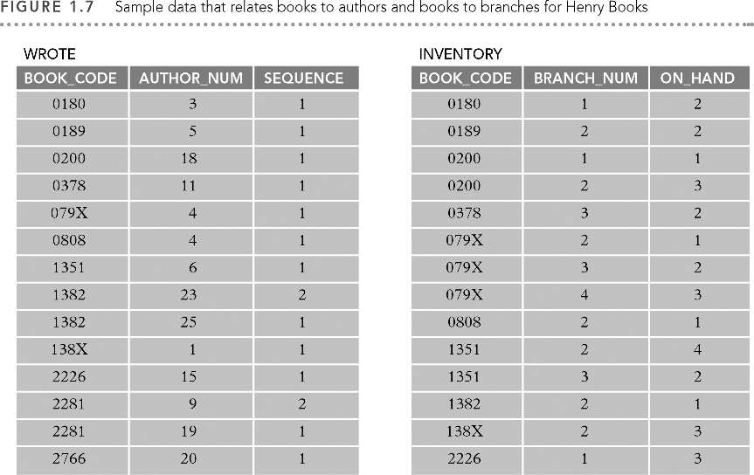

Slide 36
The Alexamara Marina Group Database
Alexamara Marina Group offers in-water storage to boat owners
Owns two marinas: East and Central
Provides boat repair and maintenance services
Uses database to store information for managing operations

Slide 37
Data for Marina Table
Marina number
Name
Full address (street; city; state; zip code)

Slide 38
Data for Owner Table
Owner number
Last name
First name
Full address (street; city; state; zip code)

Slide 39
Data for Marina_Slip Table
Slip ID, marina number, slip number
Length
Rental fee
Boat name and boat type
Owner number

Slide 40
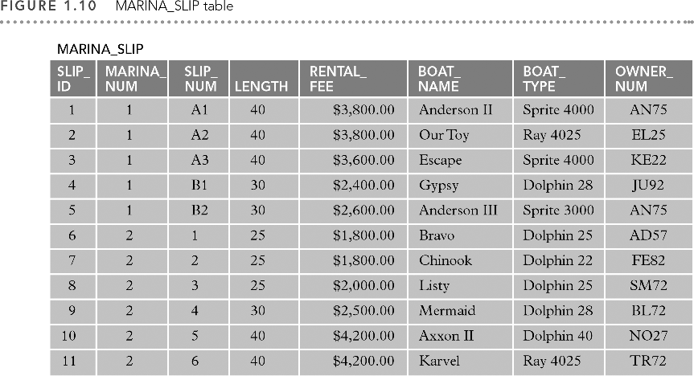

Slide 41
Service Data
Maintenance service category information is stored in the SERVICE_CATEGORY table
Information on the services requested is stored in the SERVICE_REQUEST table
SERVICE_REQUEST stores service category, slip information, description and status, estimated hours, hours spent, and next service date

Slide 42
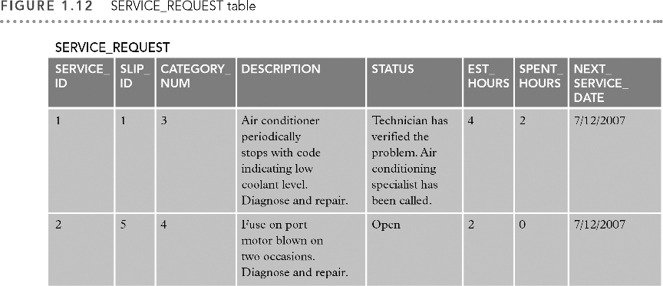

Slide 43
MySQL
Database management system (DBMS) is software that lets you:
  Create a database
  Add, change, delete, sort, and view the data in a database
Created in 1990s in Sweden
Open source software: software whose source code is freely and publicly available

Slide 44
MySQL (continued)
SQL (Structured Query Language): language for manipulating and retrieving database data
Version 4.1 used in text
Windows XP operating system
http://www.mysql.com for information
http://dev.mysql.com/downloads/ for downloads

Slide 45
Summary
Premiere Products: requires sales rep, customer, parts, orders and order lines
Henry Books: requires branch, publisher, author, book, and inventory
Alexamara Marina Group: requires marina, owners, slips, service categories and service requests
MySQL: an open-source DBMS

